Slide 1
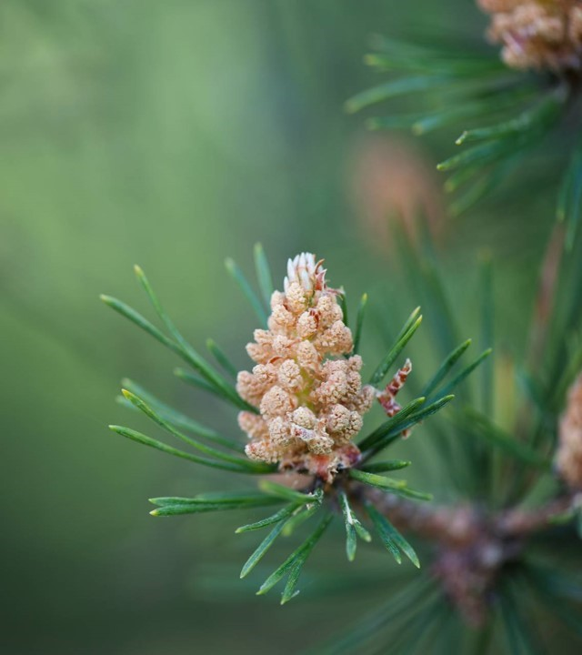
Moffat Bay Lodge
Jaci Brown Austin Moore
Jon Green

Slide 2
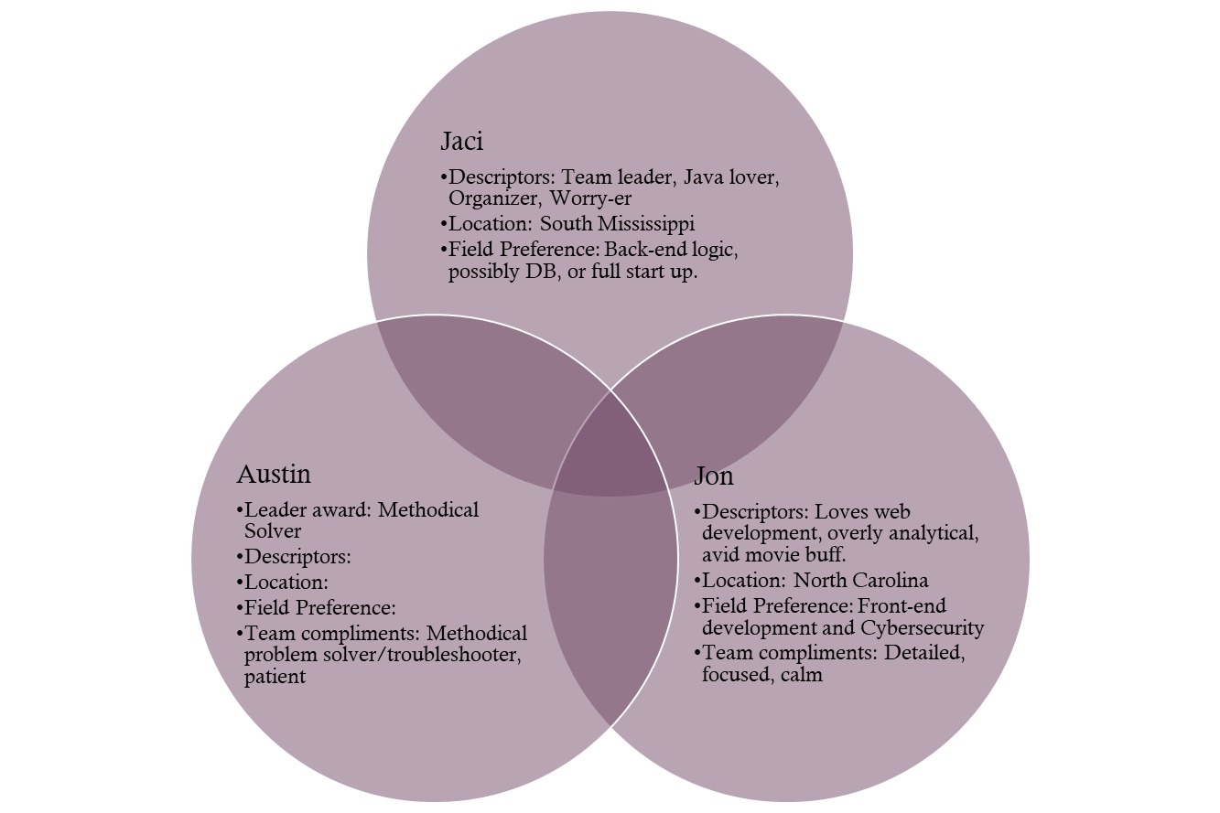
About the team
Project Requirements:
Presentation with slides for each of the following, at minimum:
Introduction of Team
Sample Prototypes
ERD
Description of at least five (5) tests created, and results of those tests
Lessons Learned as a team.
Screen Capture of live site, depicting the functionality of the following:

Slide 3
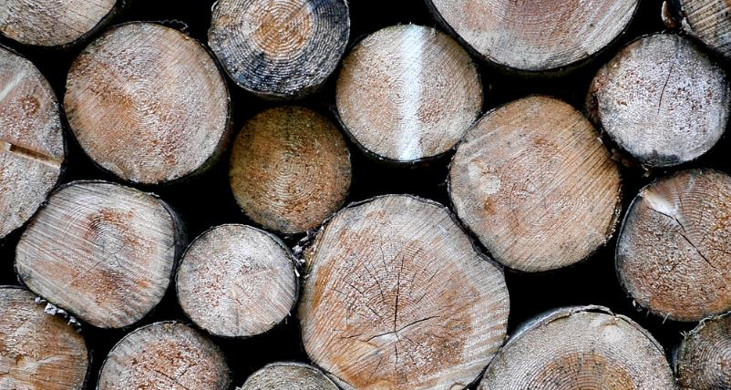
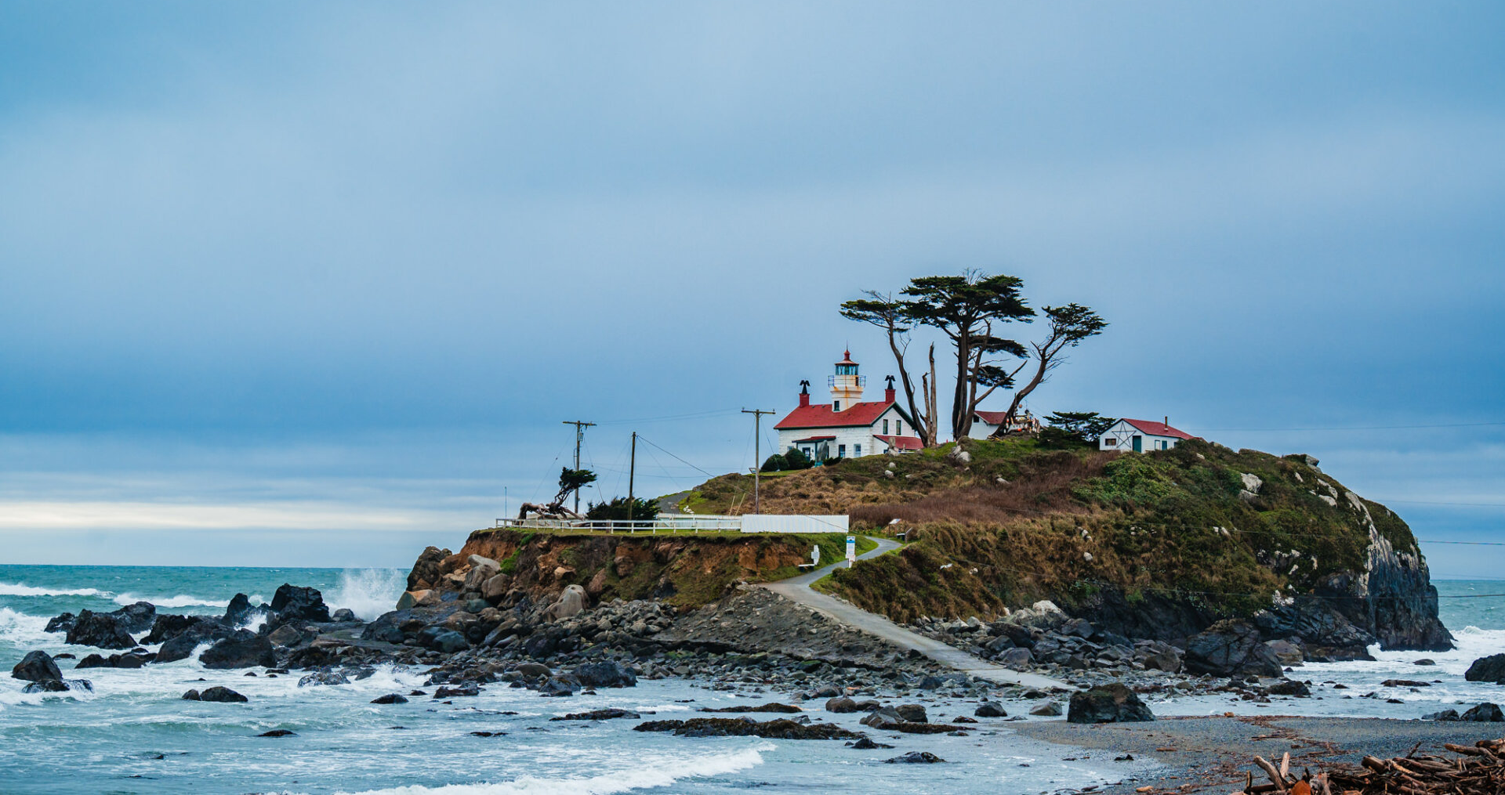
Design process
While building a website to represent Moffat Bay Lodge, we considered the surrounding area carefully. We wanted to bring to life the spirit of the experience here on Joviesda Island.

Slide 4
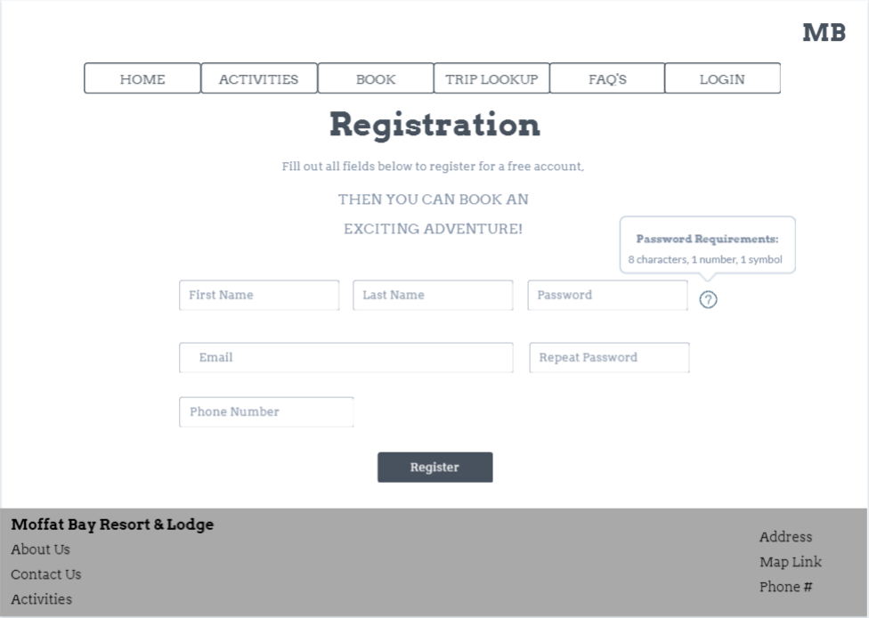
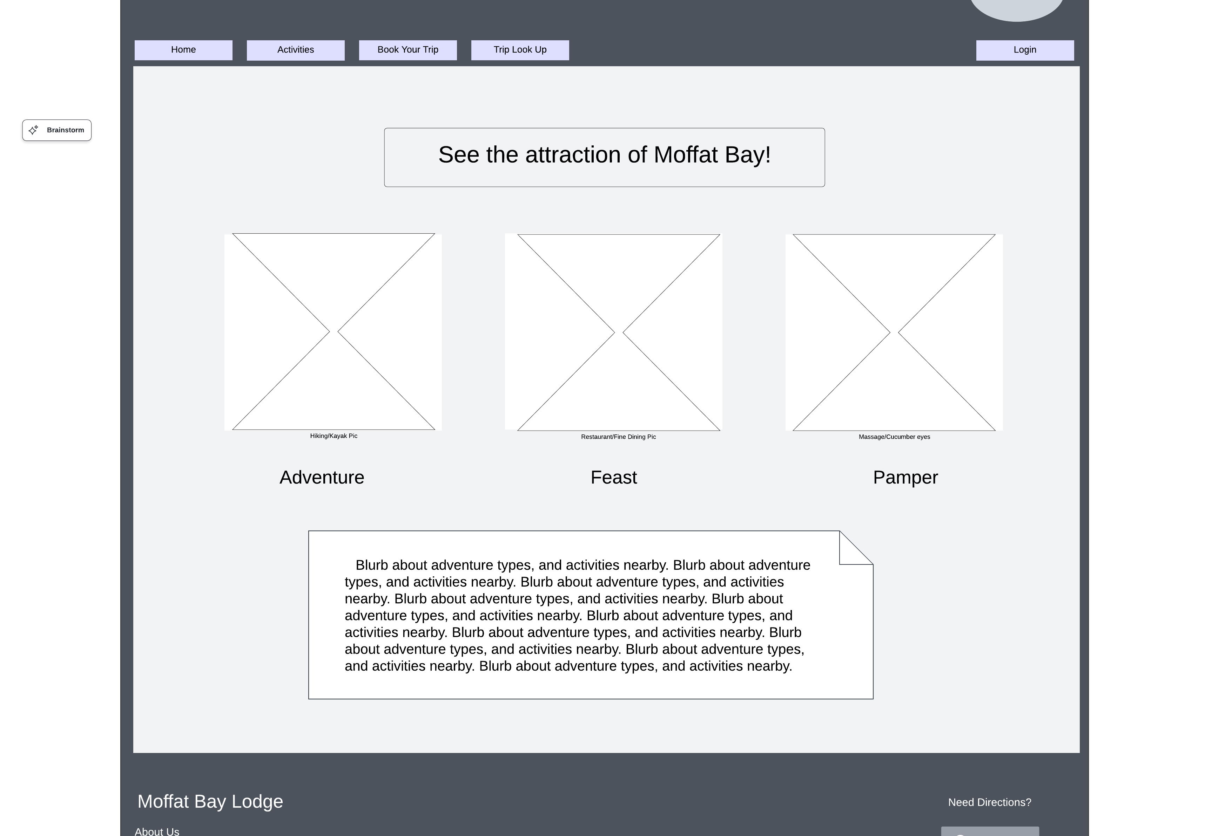
Rough prototypes
Initially, our designs were very basic. We naturally aligned to having contrast for text and menu bars. The goal was to have a mental image to hold while coding, and a way to see the requirements visually.

Slide 5
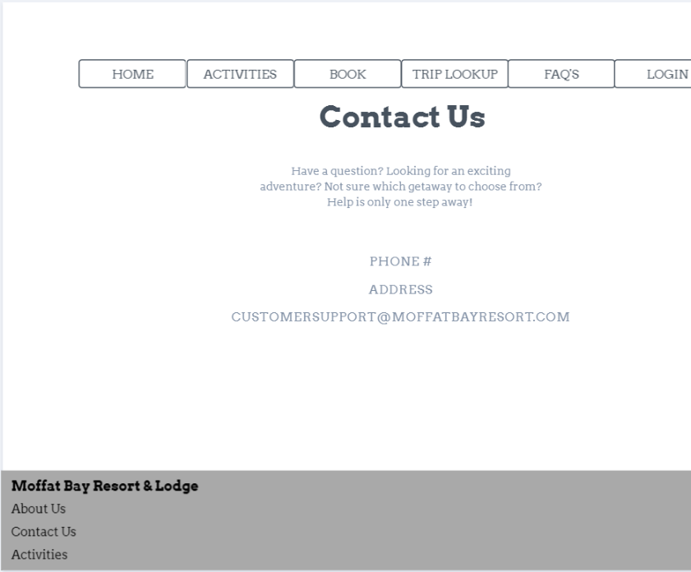
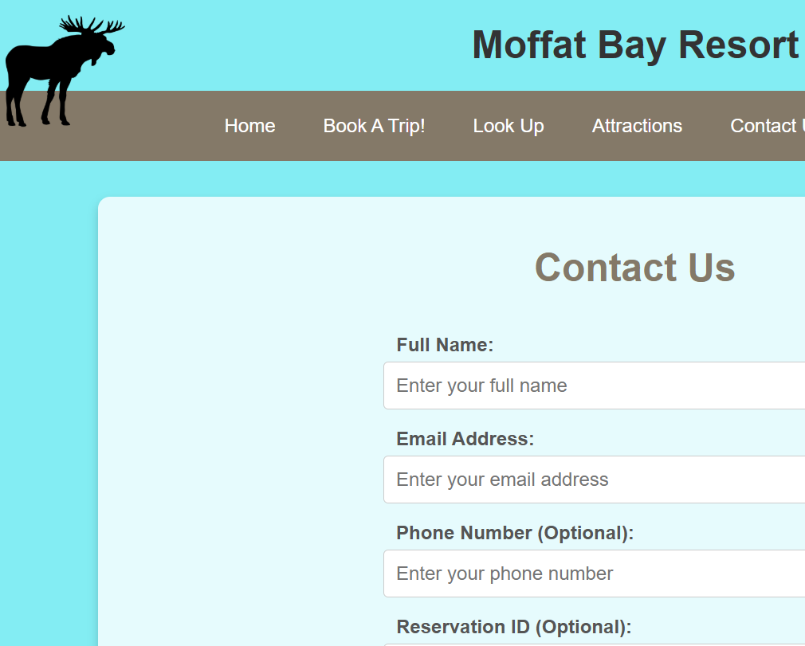
Prototypes in action:
Some of the designs evolved as we settled on a cohesive style. Representing consistency was often highlighted to increase customer trust.

Slide 6
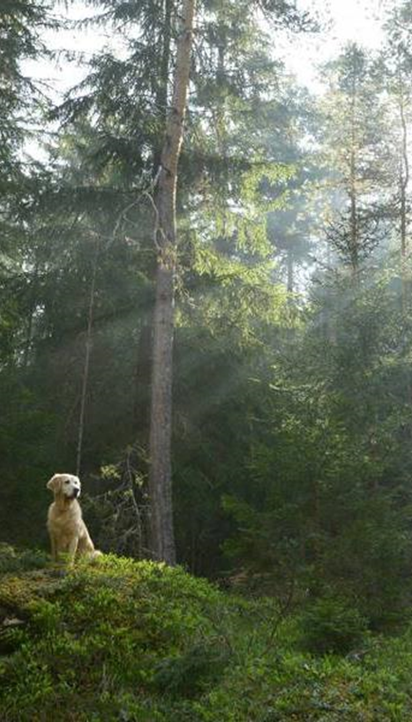
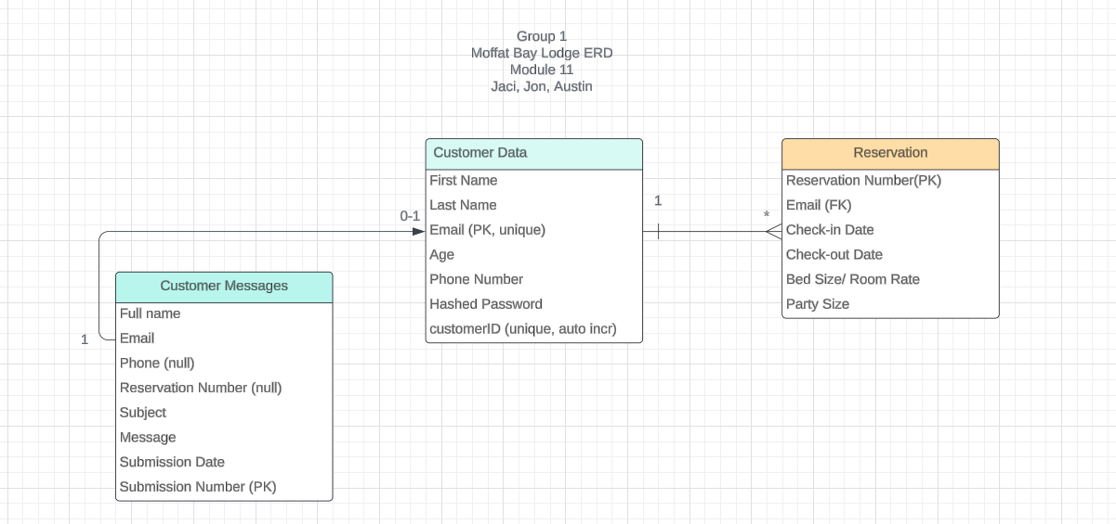
ERD AND TESTING
Our design initially only included customer data and reservations. As we began working, we soon realized we had overlooked storing the messages from the contact page. However,

Slide 7
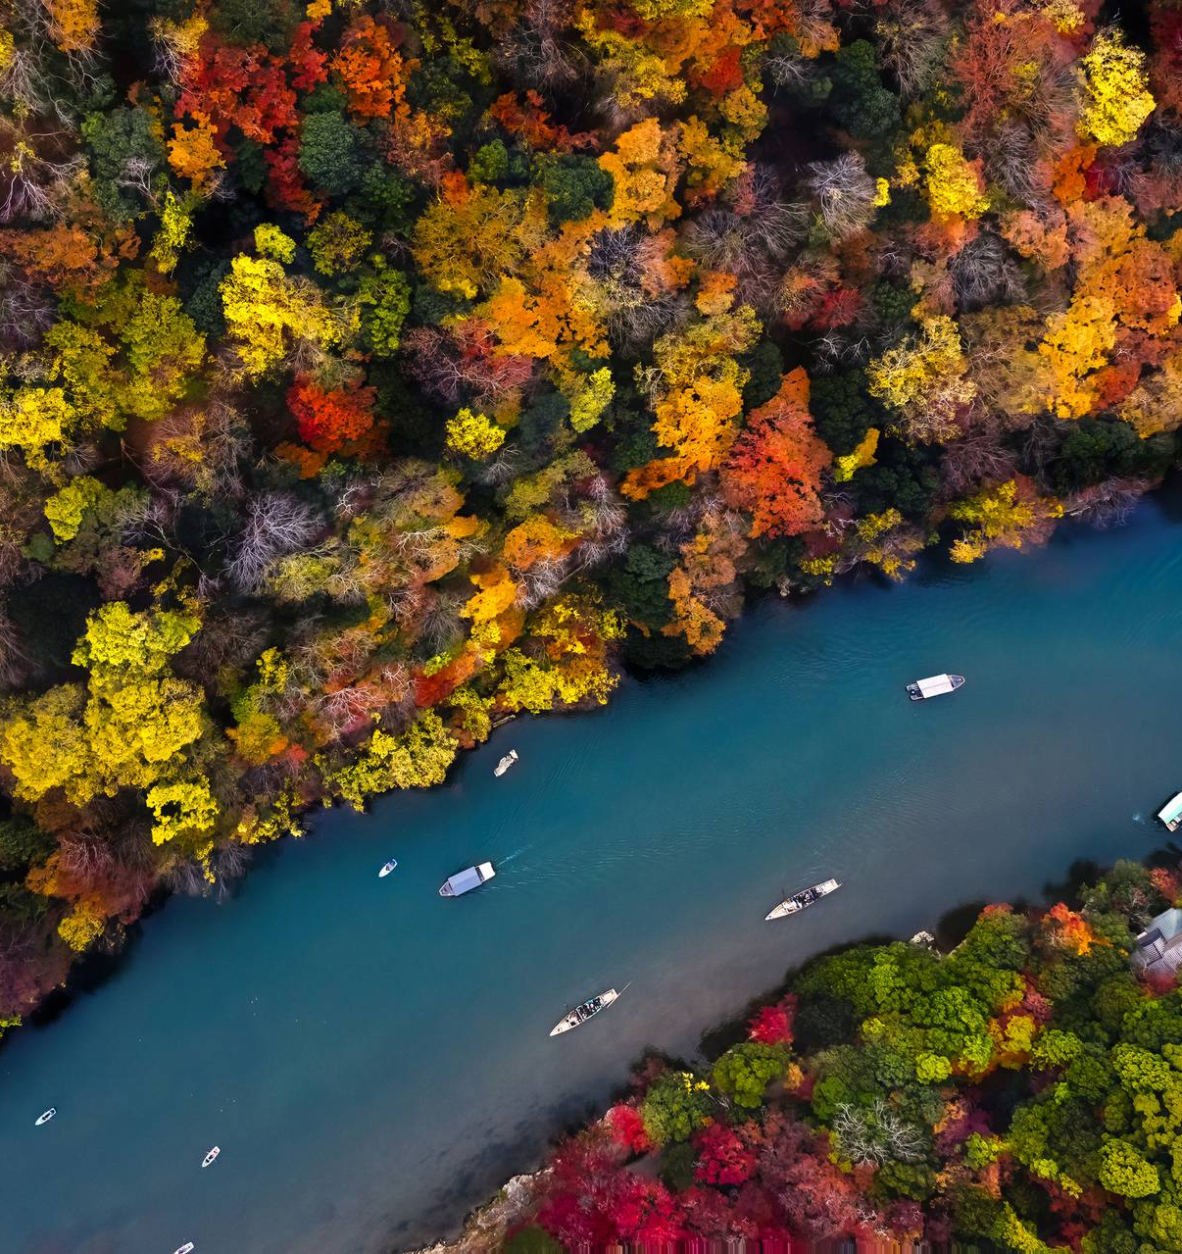
More testing
Highlight feedback/errors
“links to attractions”

Slide 8
Probably more testing
Add images and one – two sentences explaining test thought and outcome
Add pics of success and failure if possible

Slide 9
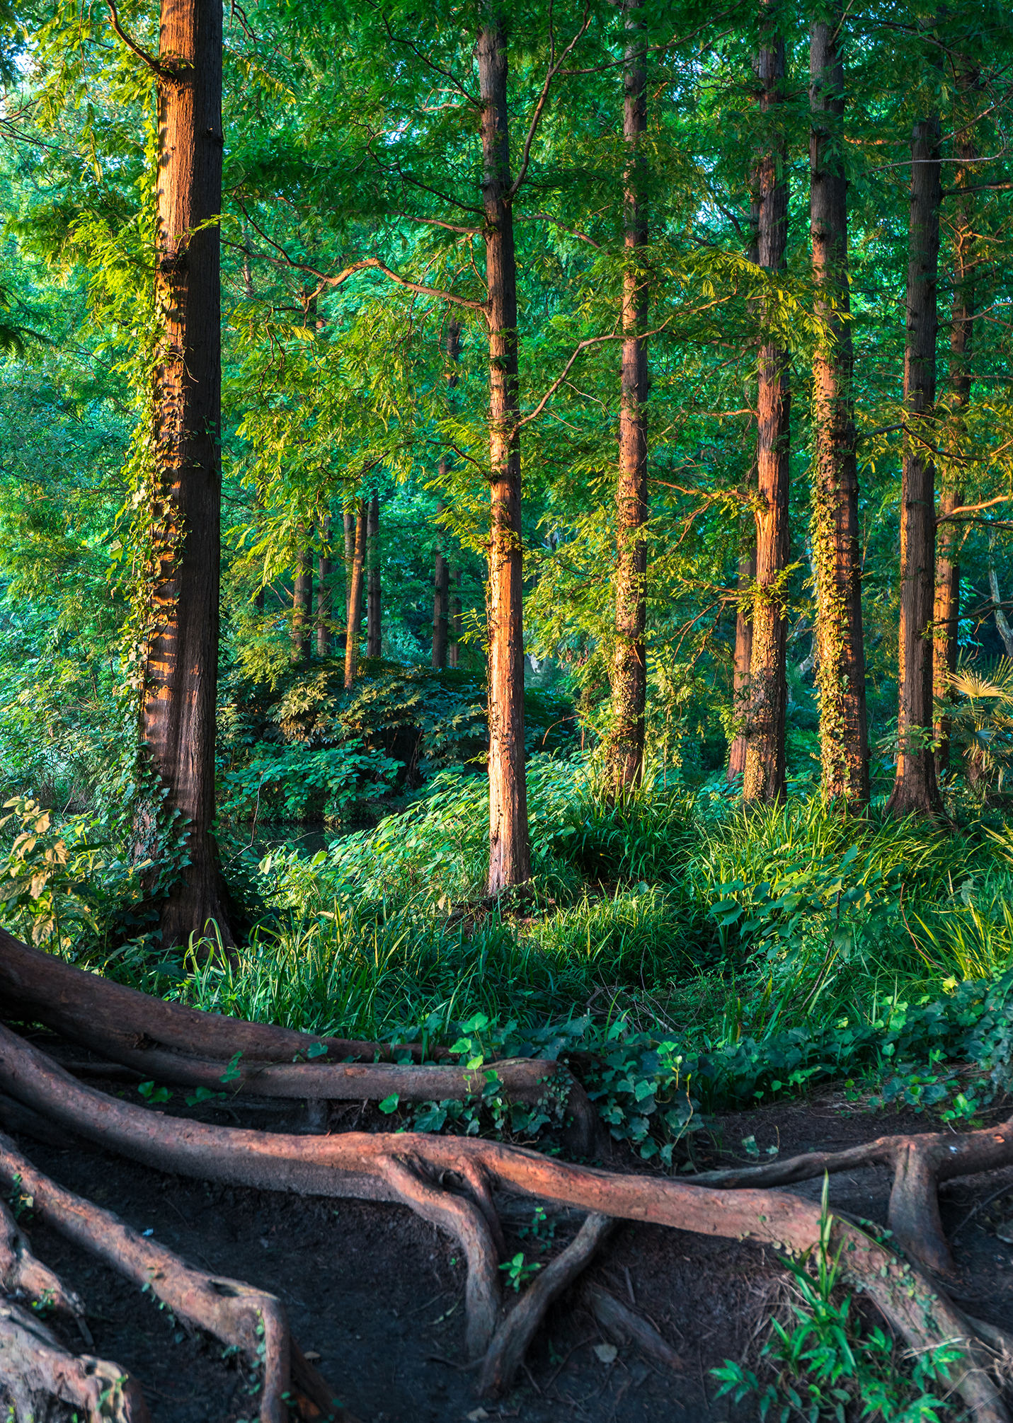
Screen captures of site

Slide 10
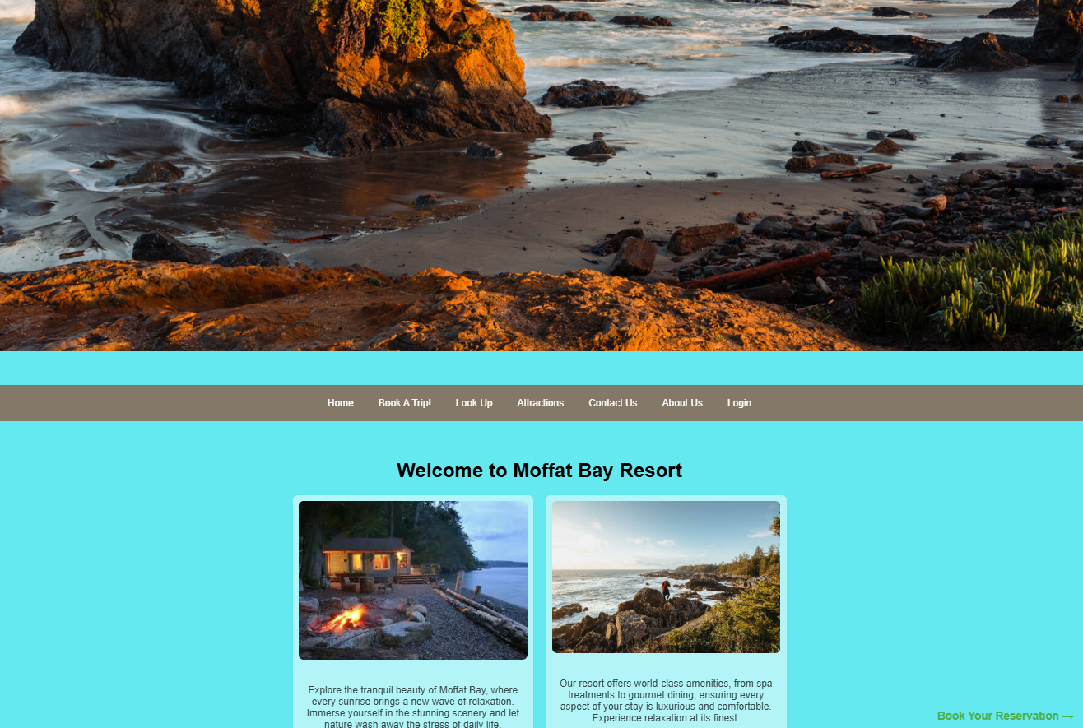
Landing page
Main picture is to capture the customers attention, showcasing amazing views by the resort. Home page has header bar along with other pictures and details of the resort overall.

Slide 11
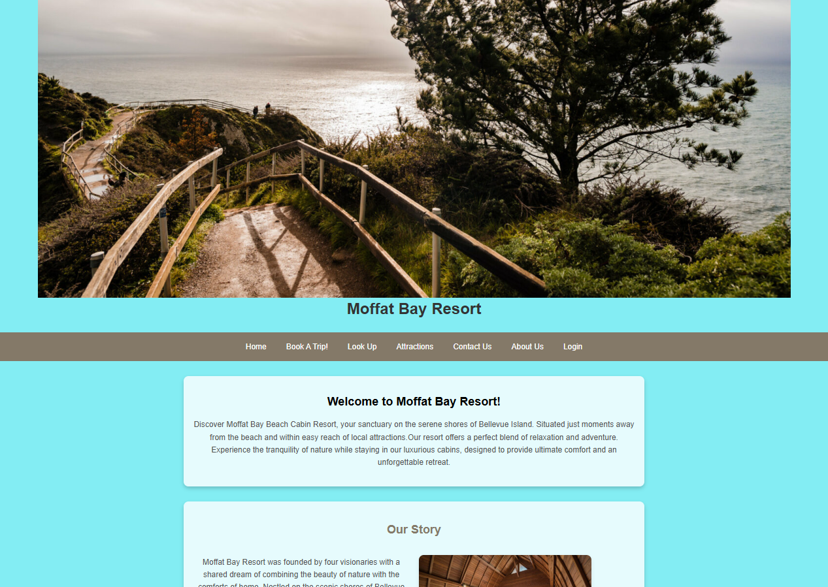
About us page
Different view of the resort at the top of the page. About Us gives more of a story and what you can experience while here along with a booking button at the bottom of the page after reading through an immersive experience.

Slide 12
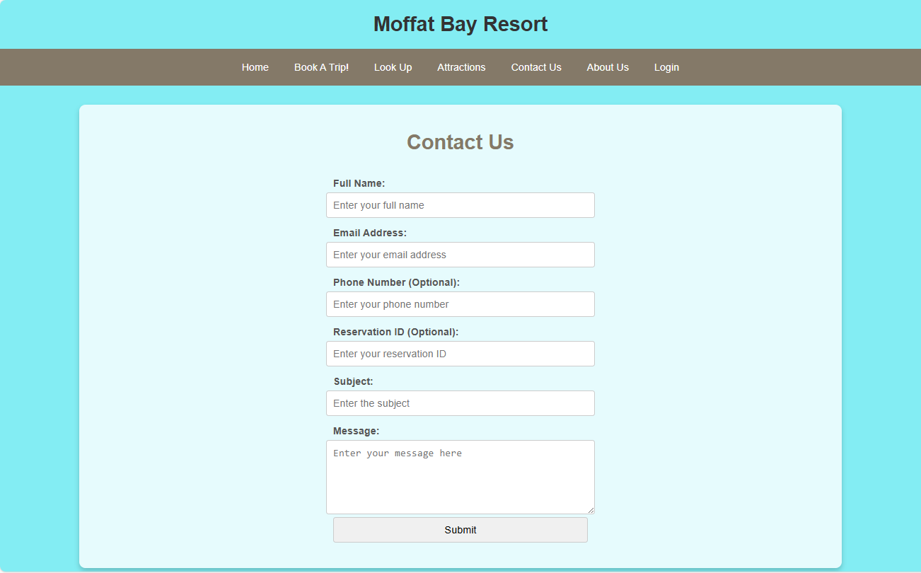
Contact us page
Contact us allows us to get in touch with you – just enter some information so we can reach out!

Slide 13
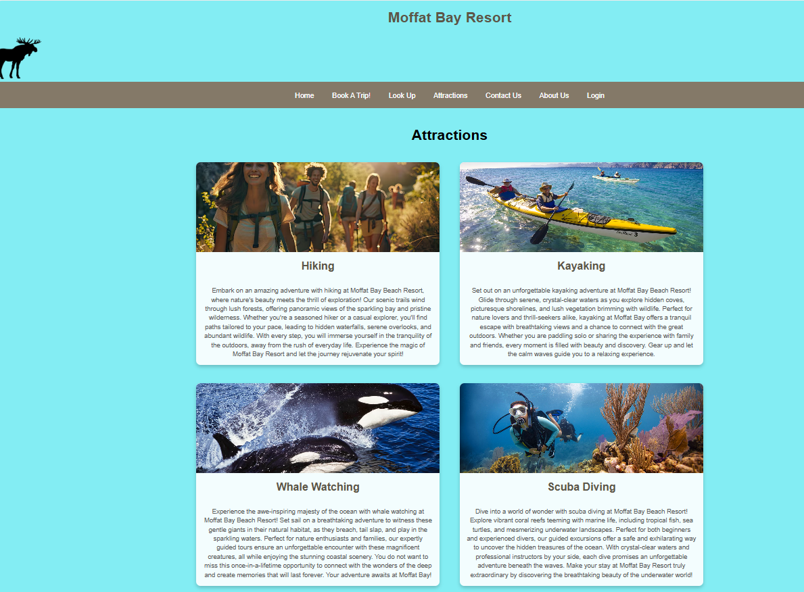
Attractions page
Attractions gives more insights to what you can experience while you stay at our resort.

Slide 14
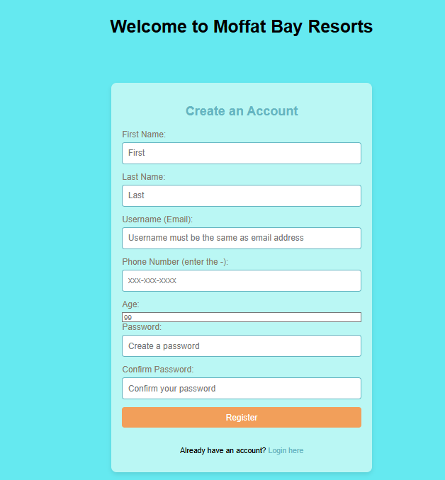
Registration page
Create an account here so you can sign in, make a booking, and lookup any existing booking.

Slide 15
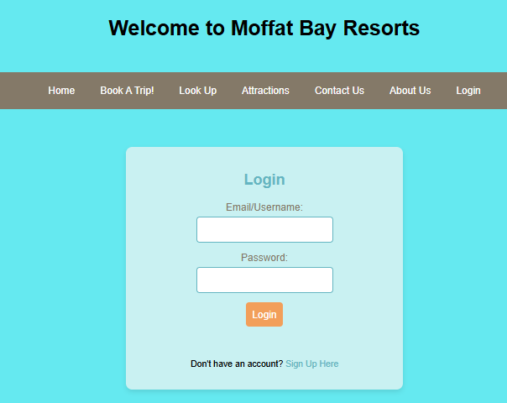
login page
Login here to make a booking and see your existing bookings.

Slide 16
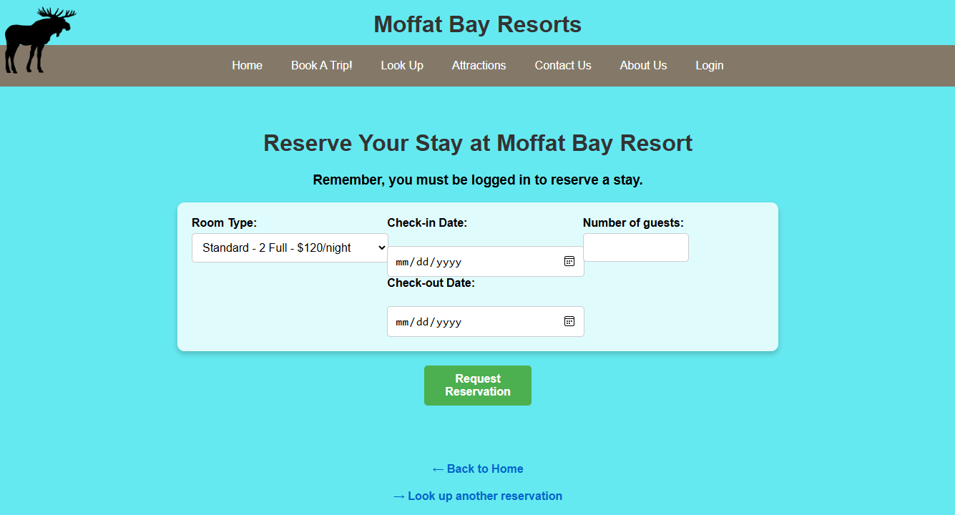
reservation page
Choose between 4 rooms (Standard, Deluxe, Formal and Presidential). A user-friendly drop-down calendar allows for easy choosing of dates.

Slide 17
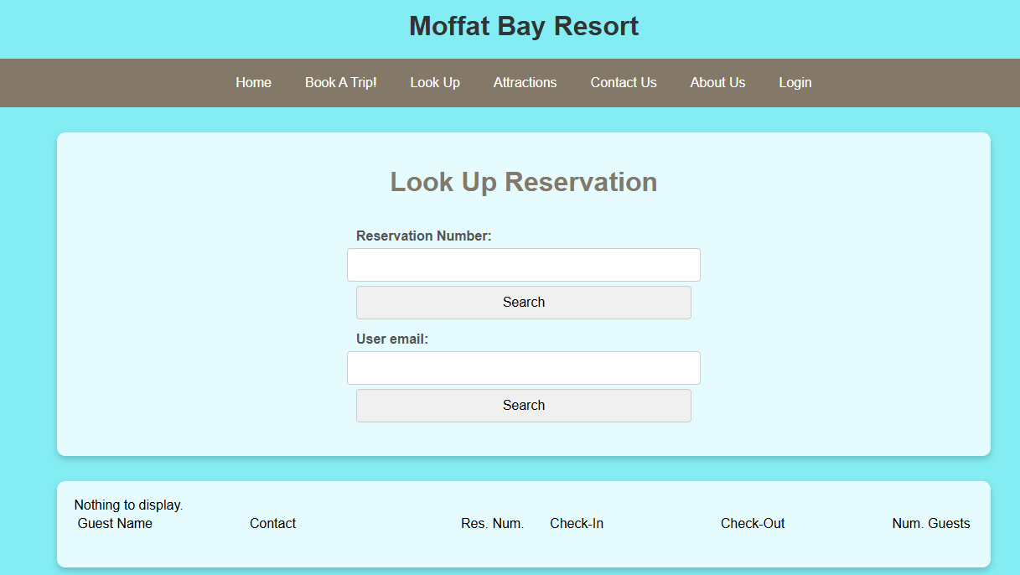
Lookup Reservation & summary page
Look up your reservation here to see your reservation number along with the details about your booking. You can look it up either through a reservation number or your email you made the booking through.

Slide 18
Favorite features
Cool features
Each devs favorite?
Only product specifically dedicated to this niche market
First beautifully designed product that's both stylish and functional
Conducted testing with college students in the area
Designed with the help and input of experts in the field

Slide 19
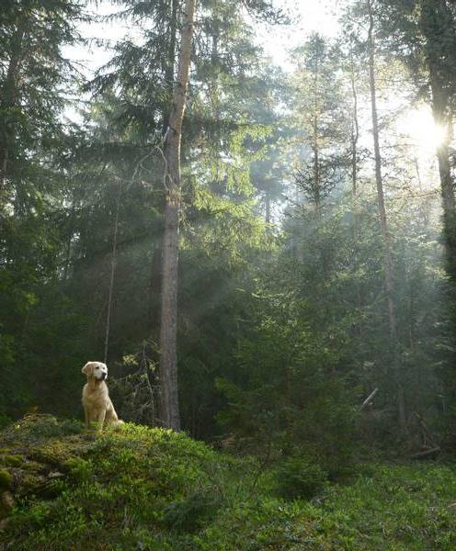
Lessons Learned
Team Environment – learning to work with each other, understand deadlines better, and overcoming obstacles
Communication – working with each others' schedules, consistent routines and assignments of tasks and realistic goals and expectations of these tasks
Dependency – learning to rely on others to complete certain tasks
Software Setup – Admin errors when using software causing the program not to run properly > specific settings within eclipse itself
Time Management – Work and School conflicts created some burdens and delays in certain completion timelines
Collaboration – Group board in blackboard not as user friendly as Discord > switched early on to have better collaboration

Slide 20
Lessons learned by the team:
I have never done well at depending on others, so relying on a group was very difficult at first. I didn't know what to expect but overall, it has turned out well in my opinion. My team excelled at working within the project structure provided by claiming tasks, offering opinions and delivering work on time, and it made the process a lot less stressful in the end due to distribution of work.
Jaci

Slide 21
Lessons learned by the team:
Jon
Working in a team environment is critical as the majority of development careers will involve this business culture. The team experience on this project has allowed me to learn quite a bit in regard to effectively working together, meeting deadlines, overcoming hurdles, as well as the importance foundational leadership in a group setting. Effective communication is key as it maintains the structure of the project and ensures that everyone’s work is consistent and on schedule. Another lesson learned is how effective communication and realistic expectations for the project work in tandem. The output must be obtainable based on a realistic time schedule, otherwise it can create an unpleasant result due to the bar being set too high.

Slide 22
Lessons learned by the team:
Software setup - ran into different issues with eclipse not running the pages properly or giving errors only on certain pages. Found that Tomcat Admin Port in eclipse was conflicting with other ports preventing pages from executing. Time management - full time work and school can really be a pain close to the holiday season. I really have to plan out my week so I can get items and tasks complete, and even create backup plans based on getting called back into work which causes disruptions in my school work. Collaboration - not necessarily a lesson learned, but learning very early on that using Discord is a lot easier to communicate than through a discussion board on the school website. Discord gives more real time help and support, along with being able to get on calls and screen share to work through problem solving was a big help.
Austin

Slide 23
Thank you
Link our git hub? And idk

